Slide 1
OpenAPI Training
SBC18 Training
Notes:
1

Slide 2
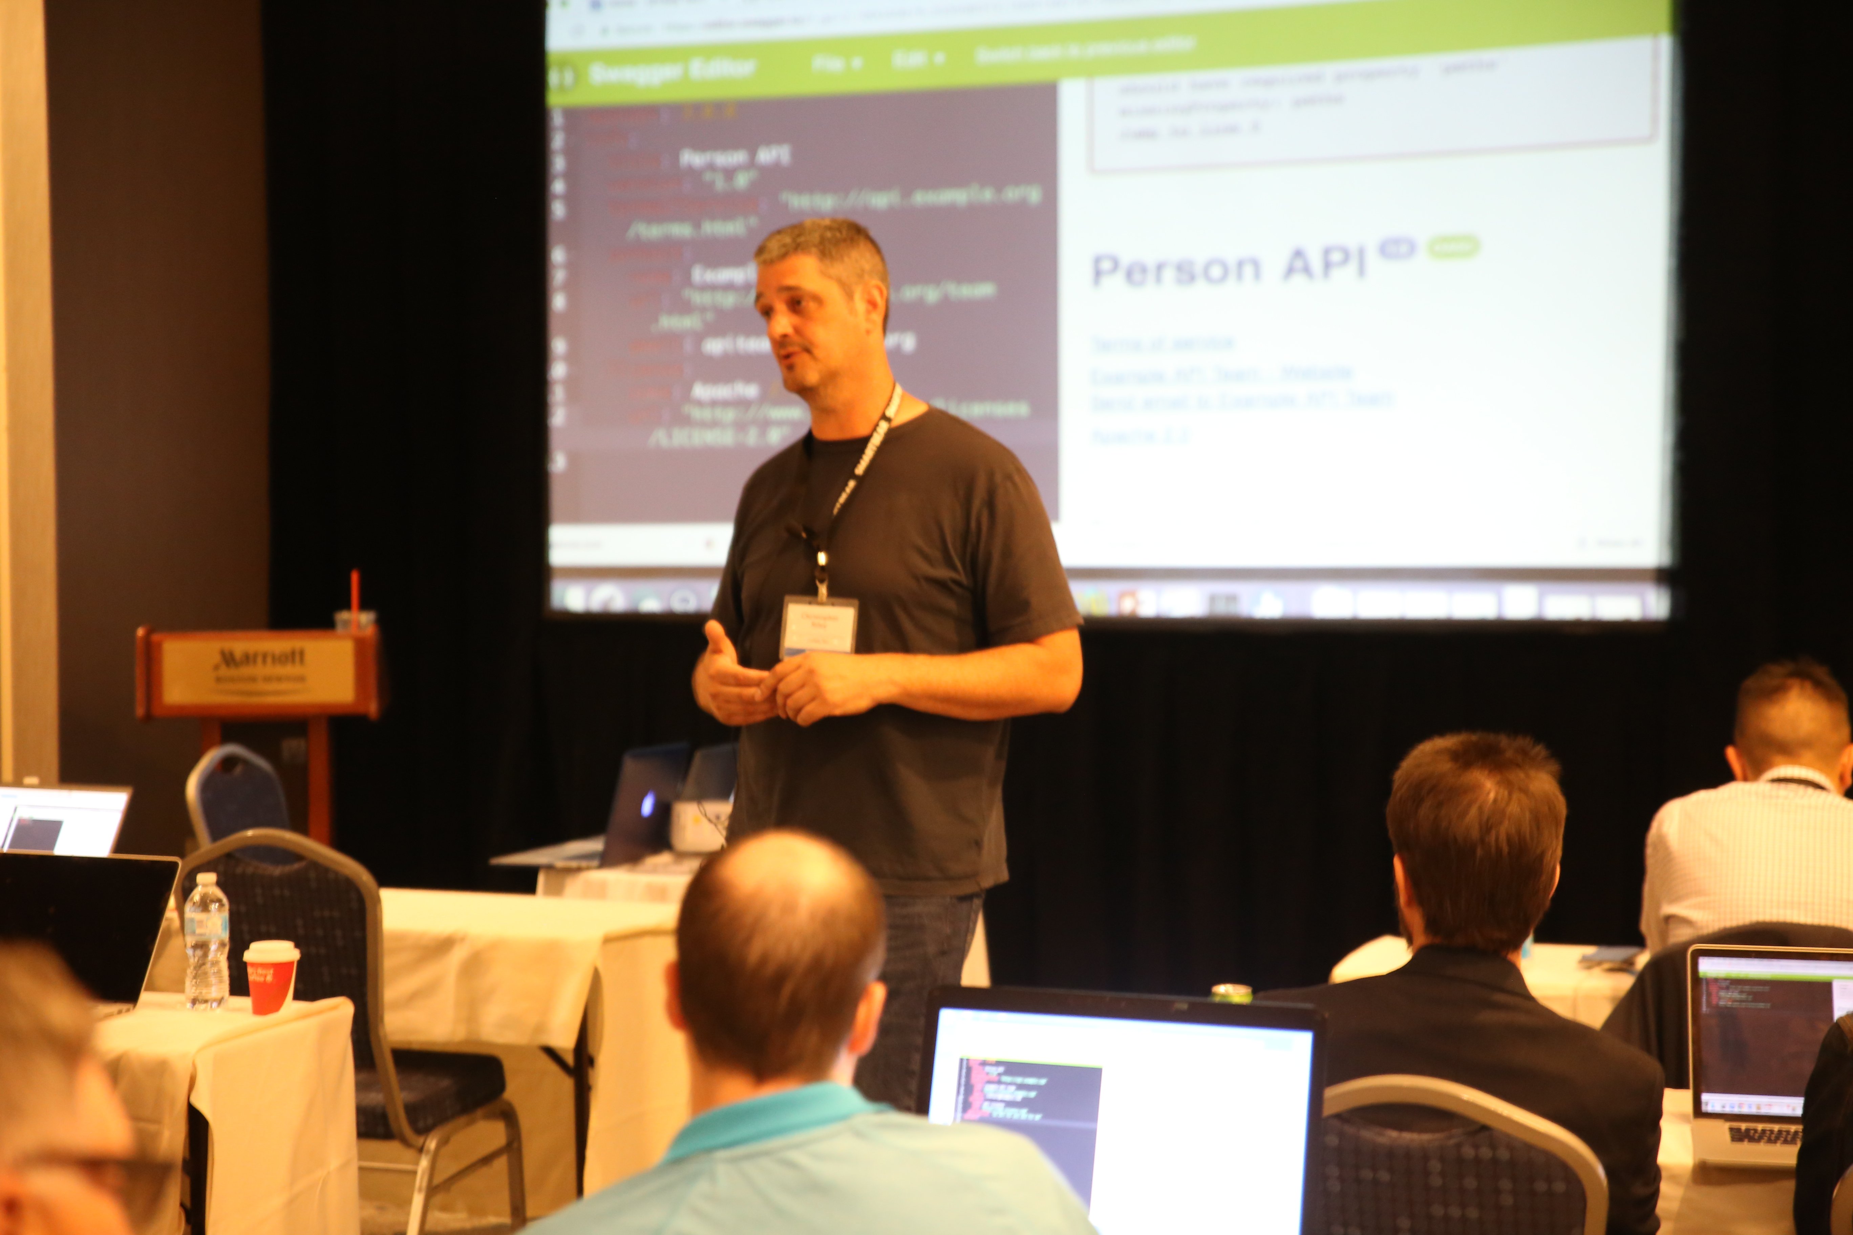
Introduction
Chris Riley
Director Solution Architecture, cPrime
SBC18 OpenAPI Training
Notes:
2

Slide 3
cPrime, Inc
Large Scale Agile Transformations
Large Scale ALM / DevOps Implementations
Technical Architecture for Digital Strategies (Cloud, APIs, Middleware)
SBC18 OpenAPI Training

Slide 4
Pre-requisites
Basic knowledge of REST
SBC18 OpenAPI Training

Slide 5
Why APIs and what simplifies their delivery?
APIs have been proven to be the number one mechanism for electronic business
APIs identify what they provide via their interface
API Consumption has been proven to increase when interface is clean, simple and well documented.
API eco-system has standardized on OpenAPI as the defacto format
API Design
API Testing
API Virts
API Implementation
API Management
SBC18 OpenAPI Training

Slide 6
What is OpenAPI?
A YAML or JSON definition of a REST API
The API Documentation standard
Standardized language to articulate HTTP, URI, MIME semantics
Eco-system of tooling to consume OpenAPI doc and provide additional value
SBC18 OpenAPI Training

Slide 7
History
2010 - Wordnik creates Swagger to help describe APIs.
2015 – Smartbear acquires Swagger and assets from Reverb.
2015 – Smartbear, Google, 3Scale, Apigee and others create OpenAPI Initiative with Swagger 2.0 as basis and renames OpenAPI 2.0.
2017 – OpenAPI releases 3.0 of OpenAPI specification.
SBC18 OpenAPI Training

Slide 8
Who can use OpenAPI?
Anyone who participates in the evolution of API based products / services
Product Manager
Business Analyst
Software Architect
QA Engineer
Lead Developer
Third-party Developers
SBC18 OpenAPI Training

Slide 9
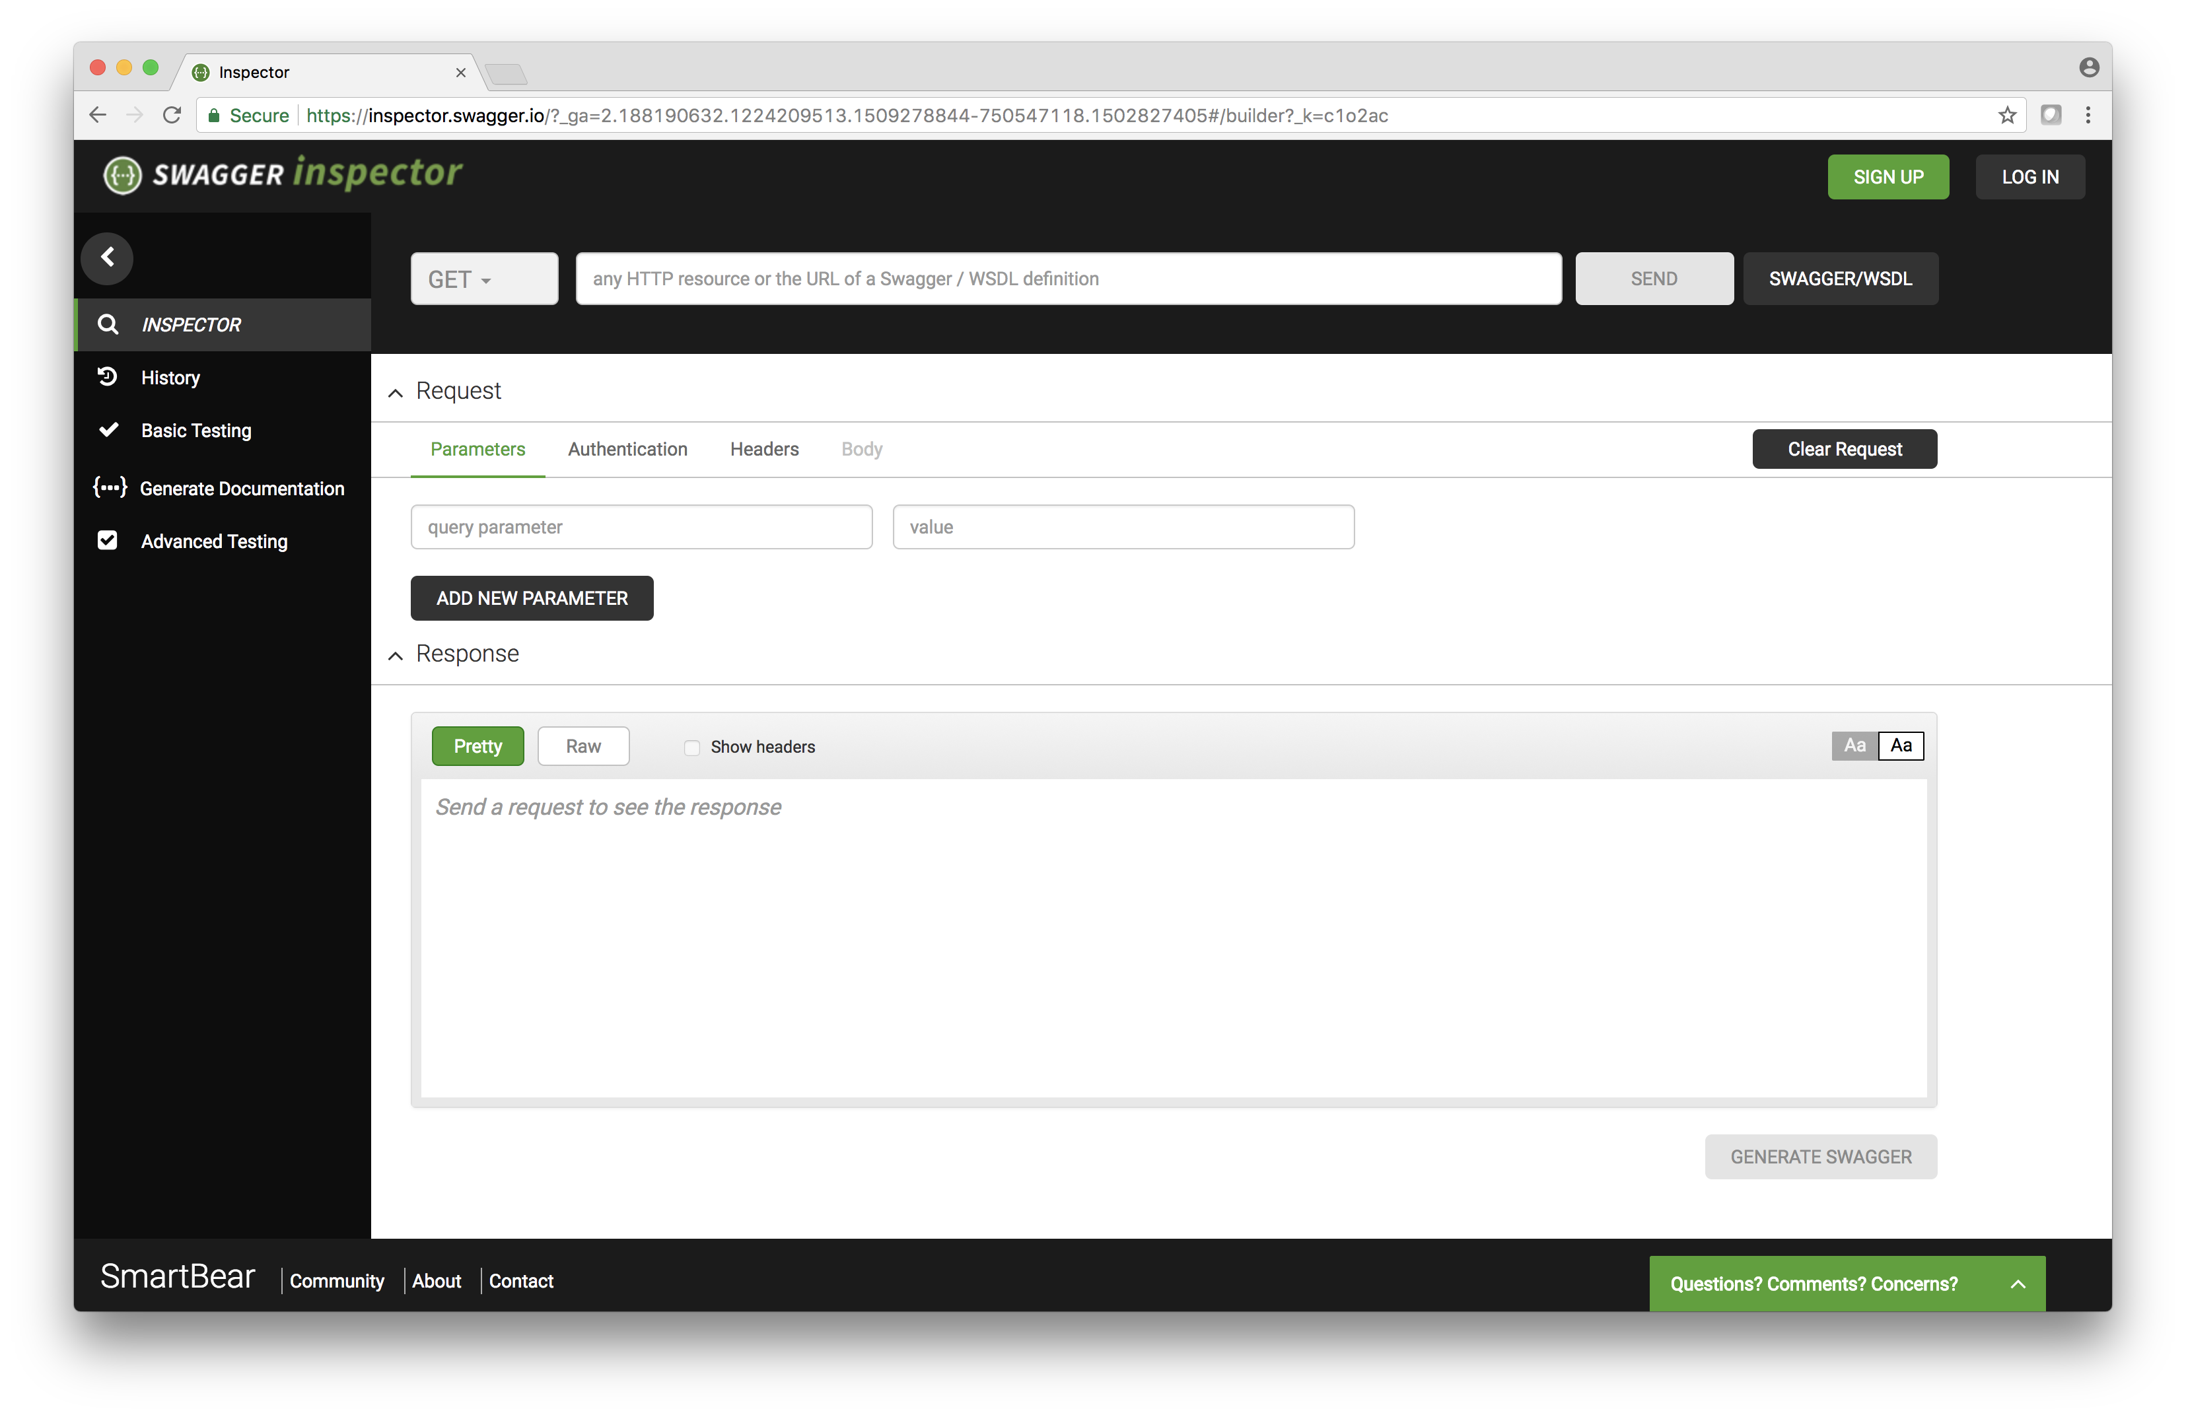
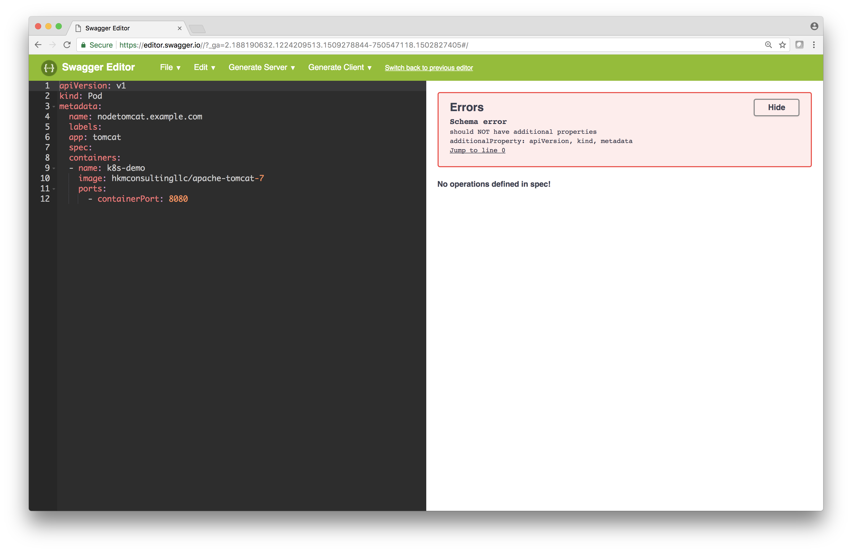
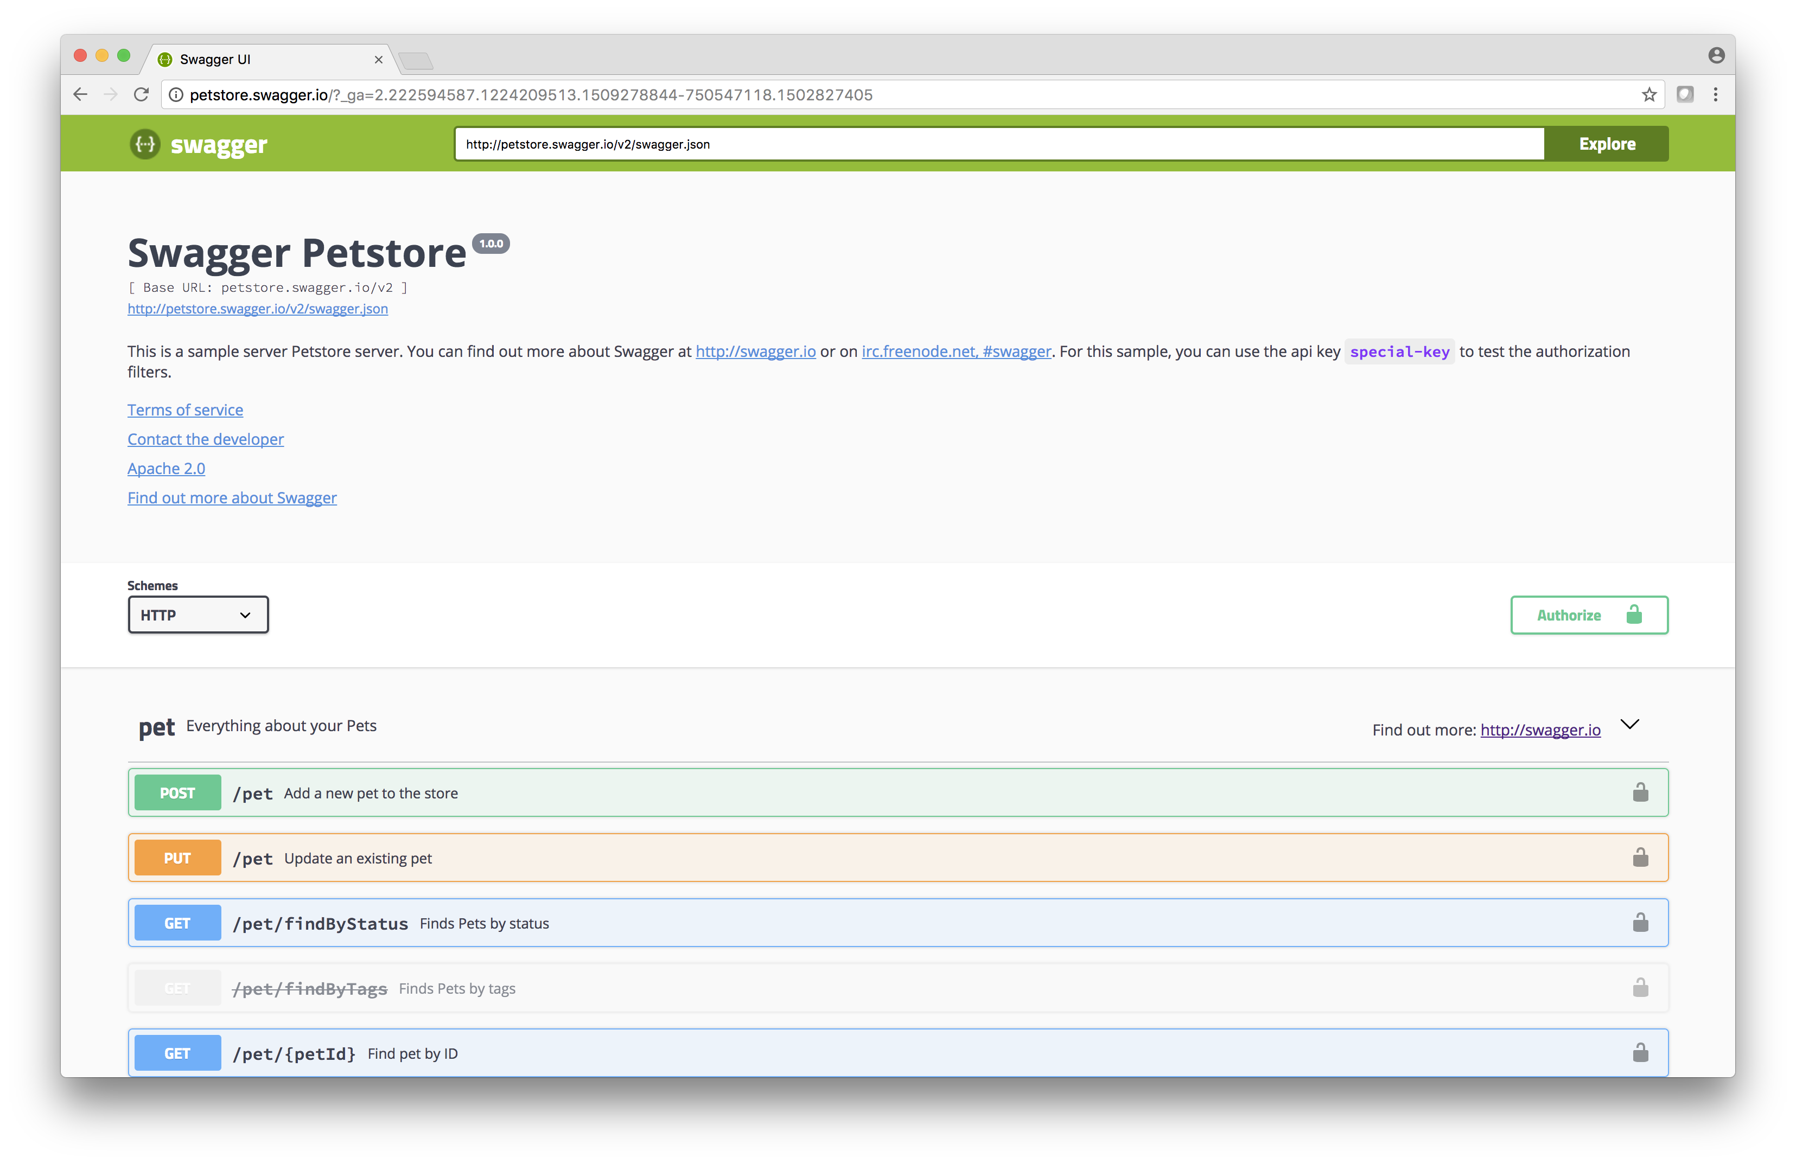
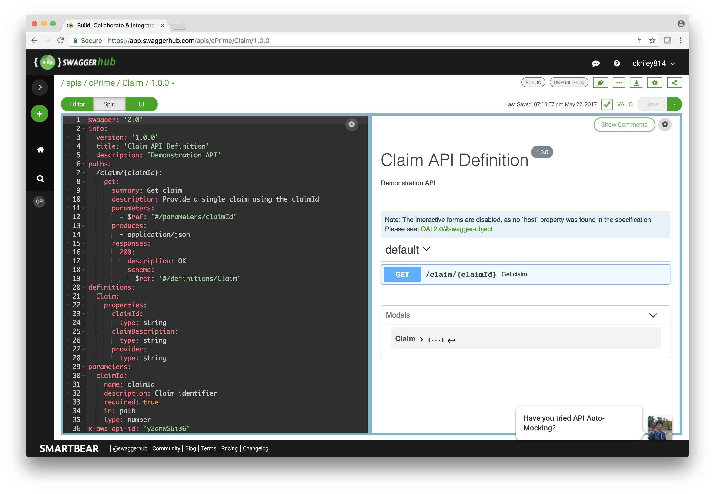
Smartbear Swagger Tooling
Inspector, Editor, Codegen, UI, SwaggerHub
SBC18 OpenAPI Training

Slide 10
What is a REST API?
Representational State Transfer, Roy Fielding Dissertation 2000
Uses HTTP, URI and HTML to share information
HTTP = How do I communicate?
URI = Where is it available to communicate?
HTML = What data am I sharing?
SBC18 OpenAPI Training

Slide 11

What is a Service?
Interface
Logic
Data

Slide 12
Interface Examples
IDL - CORBA
WSDL / XML Schema – SOAP Based Services
WADL – Yahoo Web Application Description Language
RAML / Blueprint / Swagger
OpenAPI / JSON Schema – Linux Foundation
SBC18 OpenAPI Training

Slide 13
Swagger 2 to OpenAPI 3
Restructuring / Simplification
SBC18 OpenAPI Training
Notes:
13

Slide 14
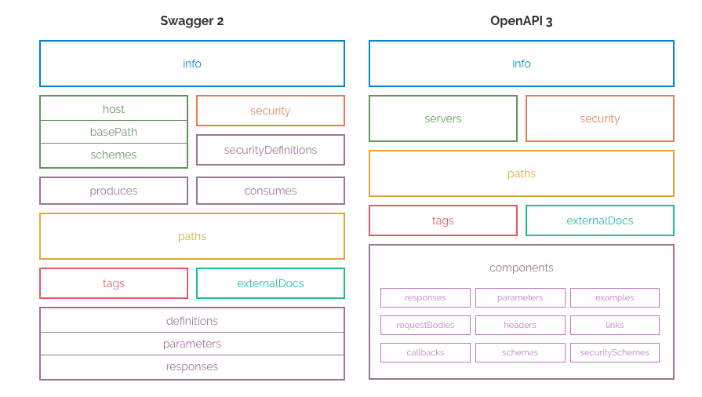
OpenAPI 2.0 to OpenAPI 3.X
Image from: https://blog.readme.io/an-example-filled-guide-to-swagger-3-2/
SBC18 OpenAPI Training

Slide 15
Class Prep
Login to SwaggerHub
SBC18 OpenAPI Training
Notes:
15

Slide 16
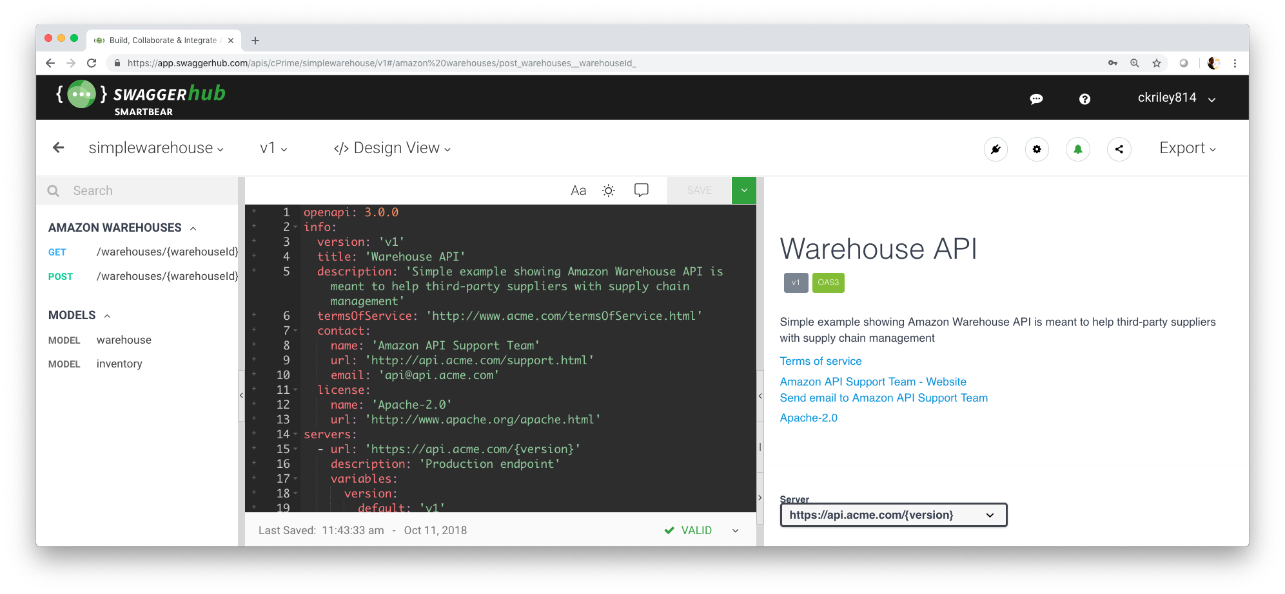
SwaggerHub
https://swagger.io/tools/swaggerhub/
SBC18 OpenAPI Training

Slide 17
OpenAPI / Example Overview
API Documentation Standard
SBC18 OpenAPI Training
Notes:
17

Slide 18
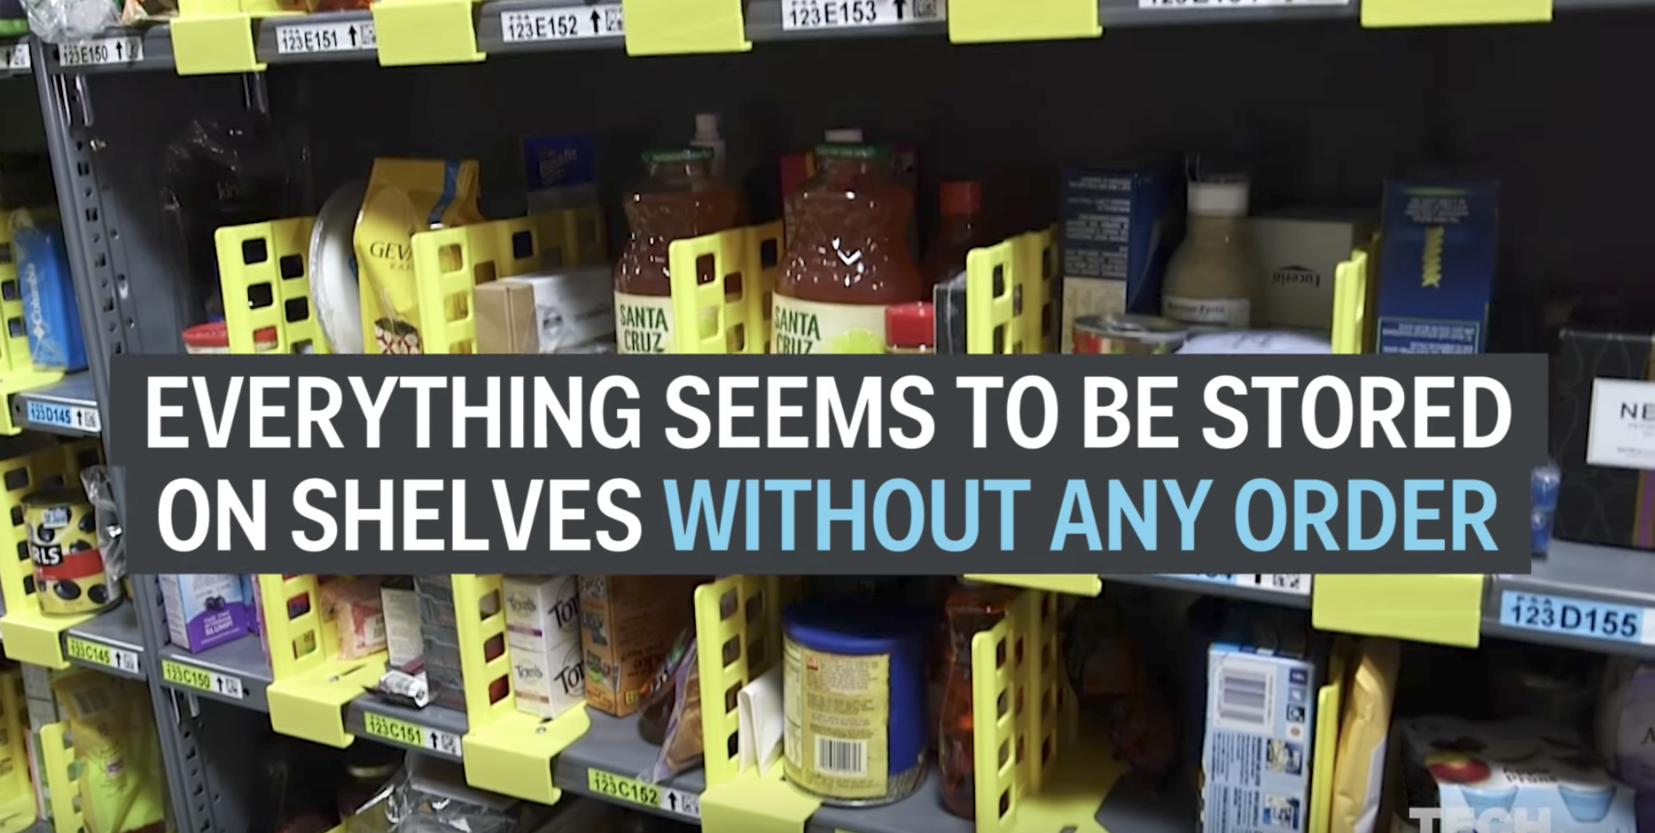
Training Exercise
Amazon Warehouse: Tech Insider https://www.youtube.com/watch?v=5TL80_8ACPc
SBC18 OpenAPI Training

Slide 19
Characteristics
Chaotic Storage, fill up available space quickly / evenly
Every item that is stocked is scanned and where it is located is scanned
Database stores these details and generates manifest for pickers to create a shipment
Workers use hand-held device to read manifest of product and locations.
SBC18 OpenAPI Training

Slide 20
Data
Warehouse Identifier
Stock Keeping Unit (SKU) – Barcode based
Location in Warehouse – Barcode based
Quantity
https://app.swaggerhub.com/apis/cPrime/simplewarehouse/v1
SBC18 OpenAPI Training

Slide 21
Info Object
Metadata about the API
SBC18 OpenAPI Training
Notes:
21

Slide 22
Info Object
Metadata about the API
Who, what, where (contact, license, hostname information)
API Custodian
SBC18 OpenAPI Training

Slide 23
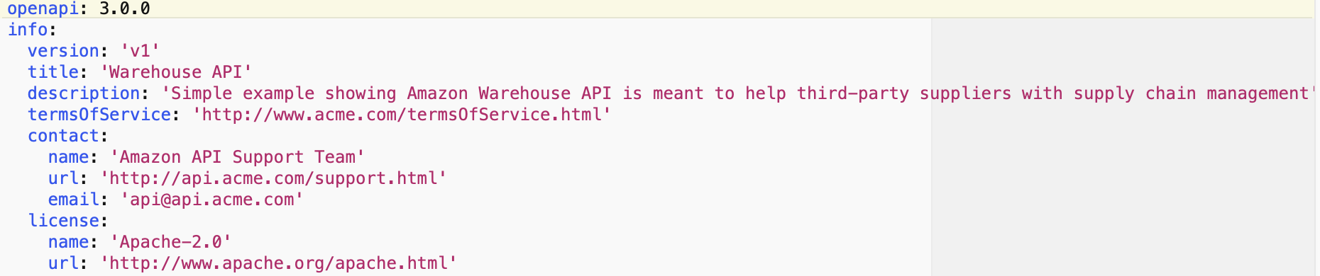
Info Object Example
SBC18 OpenAPI Training

Slide 24
Info Object Exercise
Create openapi = 3.0 entry
Create an Info Object
SBC18 OpenAPI Training

Slide 25
Servers Object
Where is the API
SBC18 OpenAPI Training
Notes:
25

Slide 26
Servers Object
Answers the where question regarding the API
One or more server / hostnames are provided along with additional meta-data such as ports, basePath or other URI variables
https://api.twitter.com/1.1/statuses/user_timeline.json?screen_name=twitterapi&count=2
server url
path
query parameters
SBC18 OpenAPI Training

Slide 27
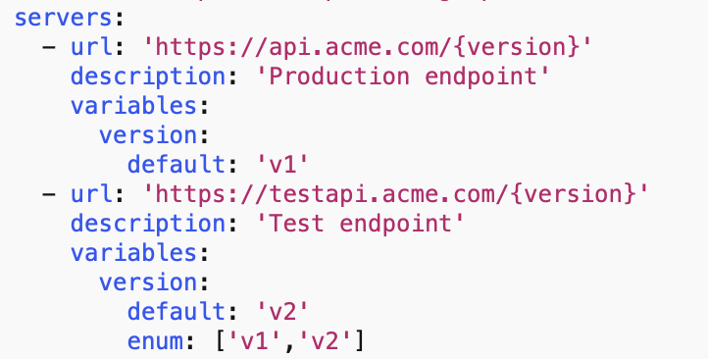
Servers Object Example
SBC18 OpenAPI Training

Slide 28
Servers Object Exercise
Create a Servers Object
SBC18 OpenAPI Training

Slide 29
Components Object
Supporting data / security definitions for the API
SBC18 OpenAPI Training
Notes:
29

Slide 30
Components Object
Encompasses schemas, parameters, securitySchemes, requestBody, responses, headers, examples, links, callbacks
Focuses on reusable elements and the uses reference to component in appropriate section
SBC18 OpenAPI Training

Slide 31
Schemas Object
API Data
SBC18 OpenAPI Training
Notes:
31

Slide 32
Schemas Object
Using JSON Schema, the Schemas Object identifies the JSON payloads that are received or sent by the API.
Supports different data types including string, number, boolean and further classification such as int32, int64, dateTime.
Optionality, sequencing, descriptions and other meta-data provide a means to clearly define the JSON payload.
SBC18 OpenAPI Training

Slide 33
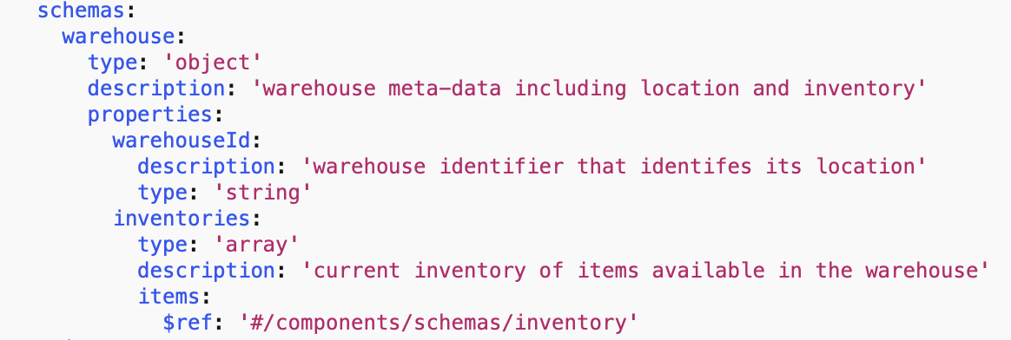
Schemas Object Example
SBC18 OpenAPI Training

Slide 34
Data Types
Base Data Types
Data Type | Examples
string | “hello”, c:/file.txt, 2017-11-12
number | Any number
integer | 1,15,22
boolean | True / False
object | JSON Object
array | JSON Array
Note: Mixed types are supported via oneOf, anyOf
SBC18 OpenAPI Training

Slide 35
Number with format
How to further articulate specific number / integer types
Data Type | Format | Description
number | -- | Any number
number | float | Floating-point numbers
number | double | Floating-point numbers with double precision
integer | -- | Integer numbers
integer | int32 | Signed 32 bit integers
integer | int64 | Signed 64 bit integers (long type)
SBC18 OpenAPI Training

Slide 36
String with format
How to further articulate string formatting
Data Type | Format | Description
string | date | Date notation e.g. 2017-11-12
string | date-time | Date time notation e.g. 2017-11-12T12:00:00Z
string | password | Notify UI to mask
string | byte | Base64 encoded characters
string | binary | Binary data used to describe files.
SBC18 OpenAPI Training

Slide 37
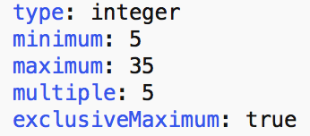
Minimum, Maximum, Multiples
Minimum, Maximum value constraints can be specified
Multiples can be used to constrain a value to a multiple
ExclusiveMinimum and ExclusiveMaximum excludes the value
SBC18 OpenAPI Training

Slide 38
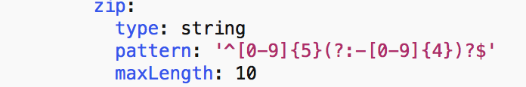
minLength / maxLength / pattern
Constrain a string to have a minimum / maximum length
Apply a pattern to constrain a string
SBC18 OpenAPI Training

Slide 39
Schemas Object Exercise
Create a Schemas Object
SBC18 OpenAPI Training

Slide 40
Paths Object
API Capabilities
SBC18 OpenAPI Training
Notes:
40

Slide 41
Paths Object
What the API Provides
URL, MIME Types, Parameters Object, Responses Object
SBC18 OpenAPI Training

Slide 42
Determine Interaction
What Verb, Request, Response needs to be identified?
Parameters as input?
RequestBody as input (e.g. JSON)?
SBC18 OpenAPI Training

Slide 43
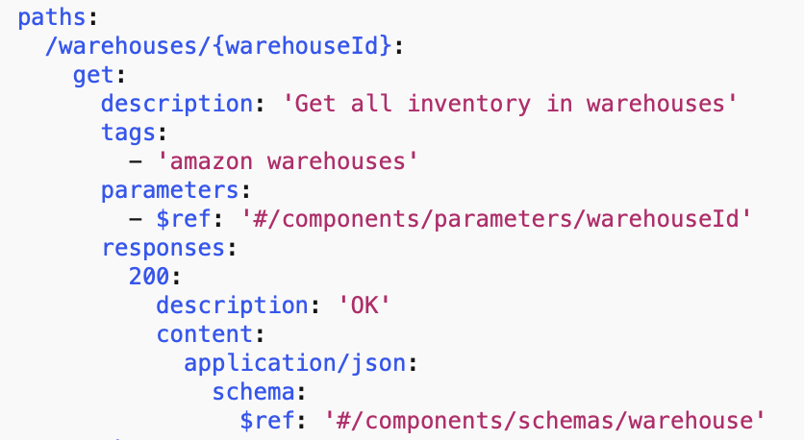
Paths Object Detailed Example
SBC18 OpenAPI Training

Slide 44
Paths Object Exercise
Create a Paths Object
SBC18 OpenAPI Training

Slide 45
$ref
Reference capabilities in OpenAPI
SBC18 OpenAPI Training
Notes:
45

Slide 46
$ref overview
OpenAPI uses $ref for referencing information within an OAS spec, outside on the file system or at a URL.
$ref: ‘#/components/schemas/elementName’
$ref: ‘../person.json#elementName’
$ref: ‘http://path to resource/#elementName’
SBC18 OpenAPI Training

Slide 47
Parameters Object
Request Data for API
SBC18 OpenAPI Training
Notes:
47

Slide 48
Parameters Object
Identifies where in the request the inbound data will reside
Path, Query, HTTP Header, Cookies
Data can be stored in a several locations (e.g. Path, Query + Header)
Can be defined under Path or at the root level for reuse
SBC18 OpenAPI Training

Slide 49
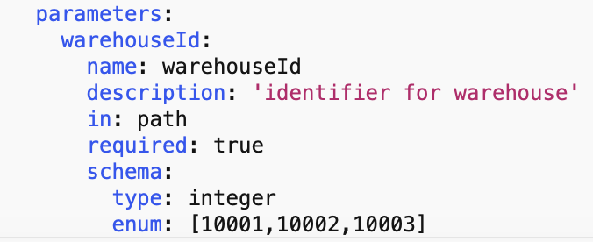
Parameter Object Example
SBC18 OpenAPI Training

Slide 50
Parameters Object Exercise
Create a Parameters Object
SBC18 OpenAPI Training

Slide 51
Media Types
Describe the API Content
SBC18 OpenAPI Training
Notes:
51

Slide 52
Media Type for Requests/Responses
MIME Type definition for a request or response
Accept: application/json
Content-Type: plain/text
SBC18 OpenAPI Training

Slide 53
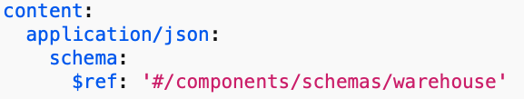
Media Type Object Example
application/json
SBC18 OpenAPI Training

Slide 54
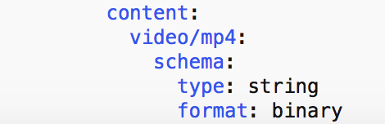
Media Type Object Example
File Upload
SBC18 OpenAPI Training

Slide 55
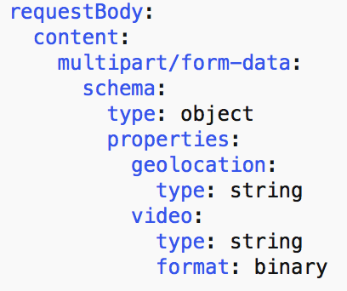
Media Type Object Example
Multipart
SBC18 OpenAPI Training

Slide 56
Media Type Object Exercise
Create a Media Type Object
SBC18 OpenAPI Training

Slide 57
Responses Object
Describe the API Responses
SBC18 OpenAPI Training
Notes:
57

Slide 58
Responses Object
Identifies how the data will be presented back to consumer
MIME Type
Associated Definition Object
SBC18 OpenAPI Training

Slide 59
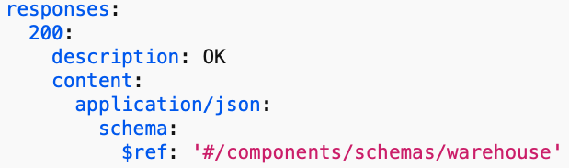
Responses Object Example
SBC18 OpenAPI Training

Slide 60
Response Exercise
Create responses for both GET and POST
For GET create 200, 4XX, 5XX
For POST create 201 and 5XX
SBC18 OpenAPI Training

Slide 61
RequestBody Object
Describe the API Request Body
SBC18 OpenAPI Training
Notes:
61

Slide 62
requestBody Object
POST, PUT, PATCH
Distinguishes Payload from Parameters
SBC18 OpenAPI Training

Slide 63
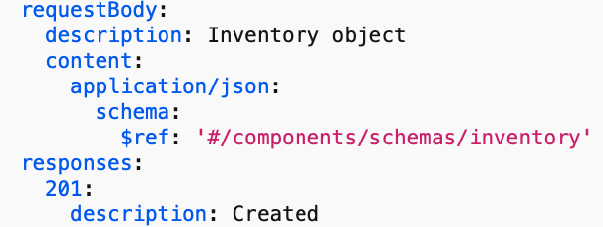
requestBody Example
SBC18 OpenAPI Training

Slide 64
requestBody Object Exercise
Create a requestBody Object
SBC18 OpenAPI Training

Slide 65
Completed Example
Version 0.1 of Warehouse API
SBC18 OpenAPI Training
Notes:
65

Slide 66
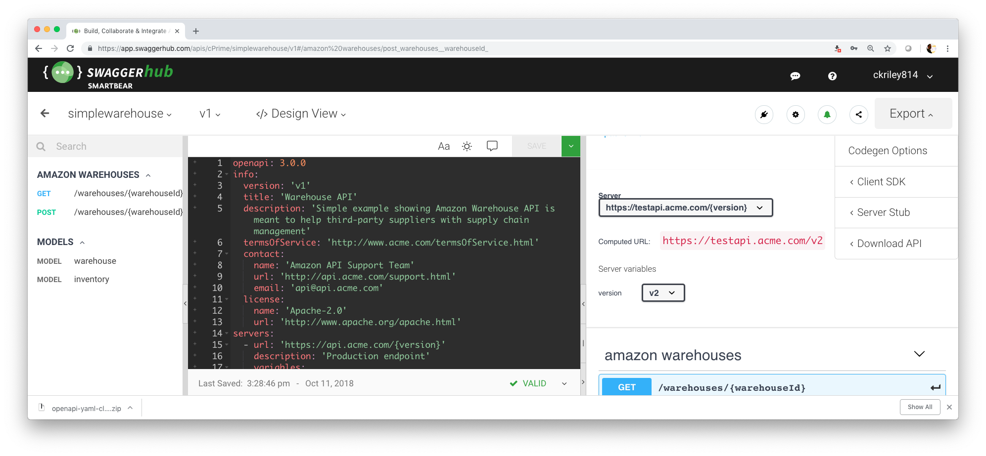
SwaggerHub -> Spring Boot -> Docker -> GKE -> ReadyAPI
SBC18 OpenAPI Training

Slide 67
Class Summary
What did we learn?
SBC18 OpenAPI Training
Notes:
67

Slide 68
Summary
API Economy continues to represent backbone of Enterprise
Clear articulation of API is critical
OpenAPI has been adopted as the way to communicate
OpenAPI eco-system is increasing every day
Participate, it is an open forum!
SBC18 OpenAPI Training

Slide 69
Thank you!
Notes:
69

